Slide 1

2020 HTA Year-End Review

Slide 2
HTA is a nonprofit 501 (c) (3) Organization
Serving the greater Houston area since 1952. HTA is dedicated to promoting tennis and its social, educational and health benefits for the city’s diverse population.
All contributions or donations are tax deductible to the maximum extent allowed by law. For more information call 281-580-8313 or log on to www.houstontennis.org.
Our Mission
To grow the sport of tennis throughout the Greater Houston area. That means players, programs, facilities, and community involvement
Our Values
Diversity and inclusion are core values: to remove barriers and create opportunities so that tennis becomes a true reflection of all of our great city.
Our Programs
Tournaments & Leagues
Scholarships for high school students
Free or low-cost academic and athletic opportunities for 6,000+ children
Support for schools and neighborhood centers.

Slide 3






PARTNER WITH HTA
The Advantage is yours!
Houston Tennis Association
3535 Briarpark Dr., Suite 215,
Houston, Texas 77042
Executive Director
Cheryl Hultquist
281-580-8313
Email: Cheryl.h@houstontennis.org
Affiliations & Sponsors

Slide 4


2020 Newsletters
Welcome to the new and returning HTA officers and board members elected at the 2019 December Annual Meeting and Holiday Party!
Officers
President: Peter Farrell, Vice President: Doug Pritchett, Vice President: Ted Erck, Secretary: Claire Goosey, Treasurer: Lara Lehmann, Executive Director: Cheryl Hultquist
Term 2018-2020: Steve Ash, Tina Beddow, Tim Calhoun, Jeni Dao, Alex Montes, Twyla Scott, Iliana Yang
Term 2019-2021: Marianne Bianchi, Corbin Cooke, Parker Dobson, Raouf Hadad, Victoria Jaeger, Kyle McCully, Tu Tran
Term 2020-2022: Mary Beth Flahery, Patricia Gardner Young, Srimonto Ghosh, Bronwyn Greer, Haley Leffler, Zachary Lessen, Preston Pinto
Game, Set, Match HTA NJTL Gala
Royal Sonesta on February 6, 2020
HTA National Junior Tennis
& Learning a four-star chapter
.

Slide 5
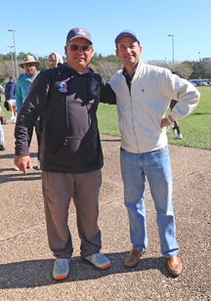
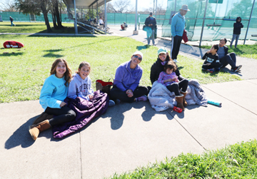
On & Off the Court RBC Wealth Management Super Championship Major Zone
RBC Wealth Management HTA Houston Super Champ Level 3 (SCMZ 12_14
RBC Wealth Management HOUSTON OPEN-ADULT MZ (Ad, Sr, SS )
RBC Wealth Management HTA Houston Super Champ Level 4 (SCMZ 16_18

Slide 6
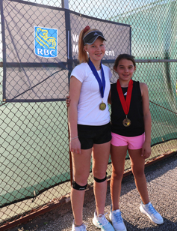
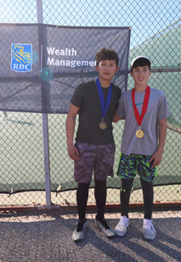
RBC Wealth Management Tournament Pictures

Slide 7
On and Off the Court
Deja Vu!
RBC Wealth Management Adult Major Zone

Slide 8
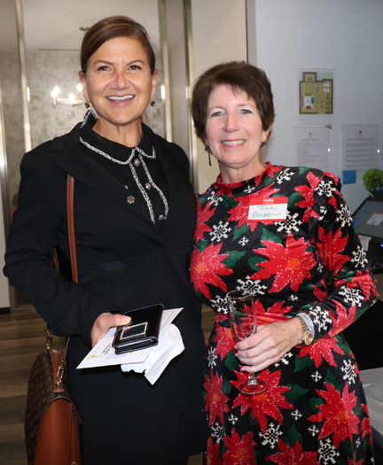
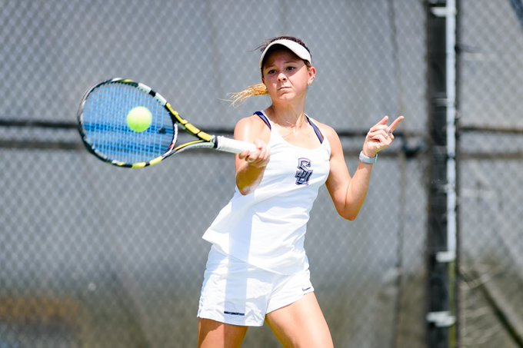
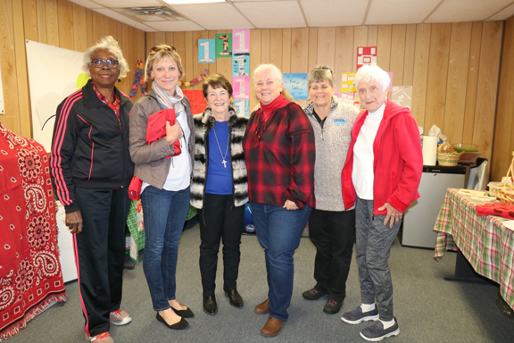
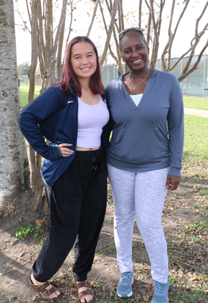
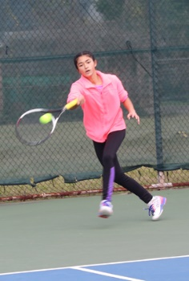
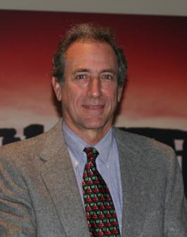
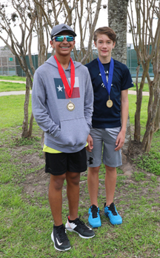
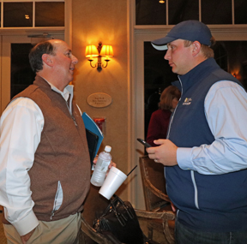
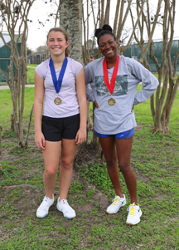
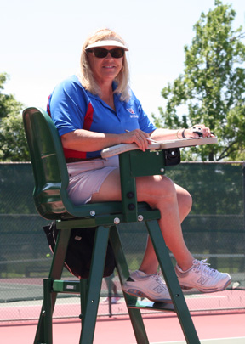
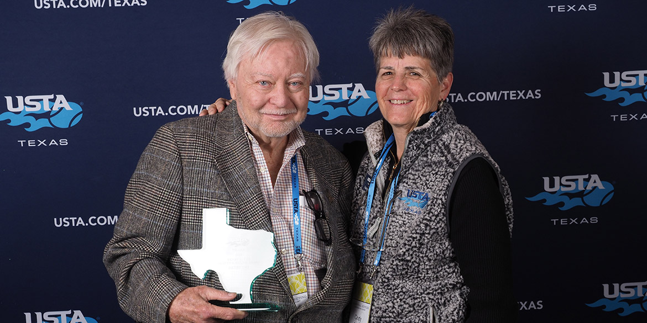
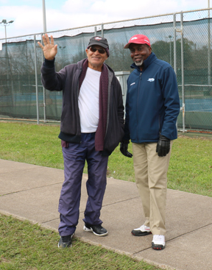
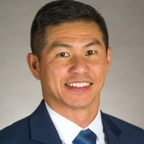
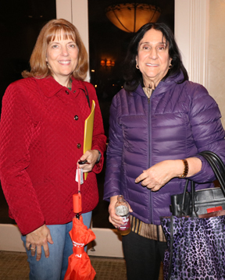
On and Off the Court

Slide 9
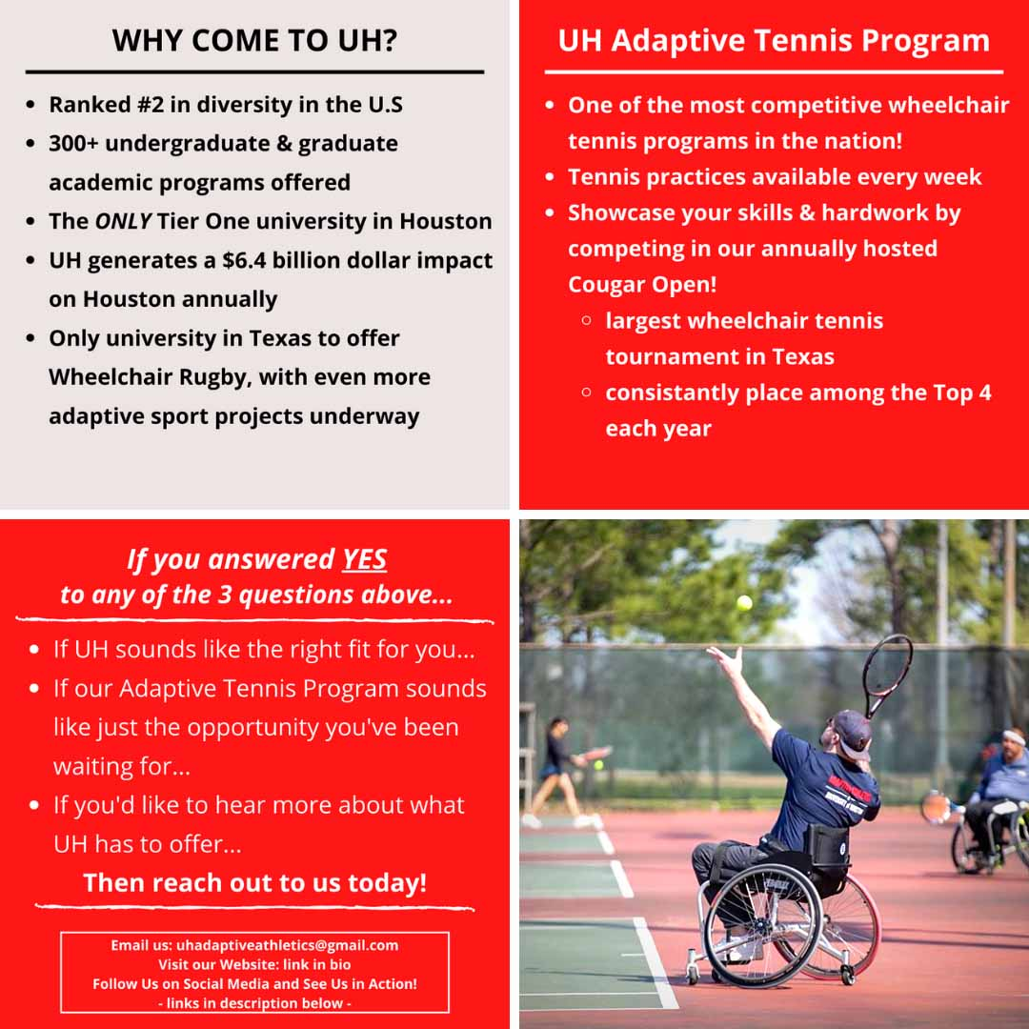
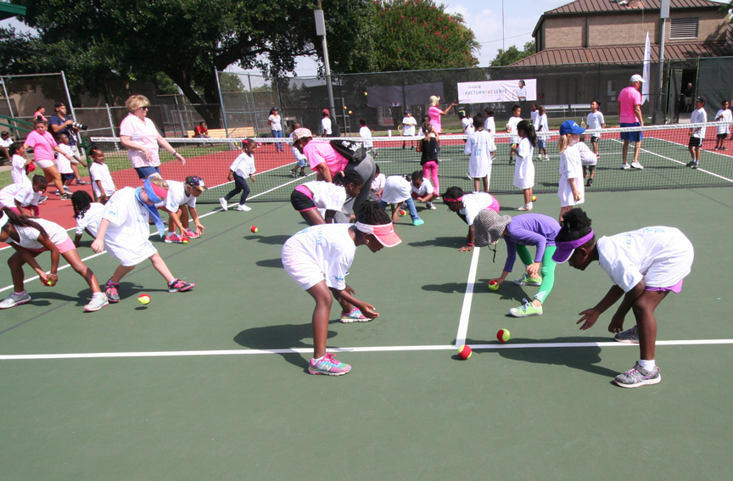
On and Off the court
HTA National Junior Tennis & Learning a four-star chapter (the highest designation)
The HTA NJTL Program is co-sponsored by HTA along with Tennis Express, Fayez Sarofim & Co. U.S. Men’s Clay Court Championship, USTA Foundation and Harris County Department of Education CASE for Kids

Slide 10
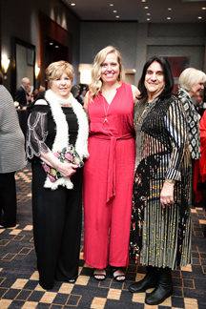
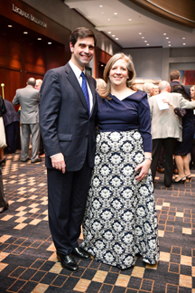
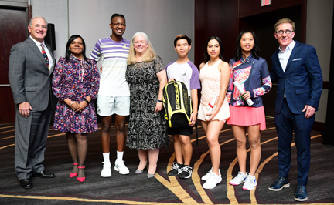
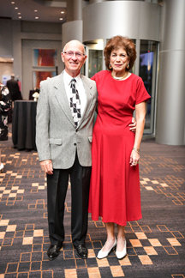
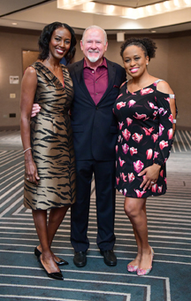
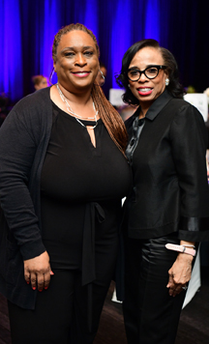
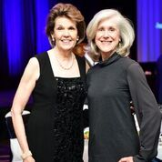
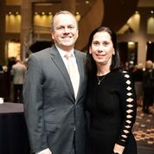
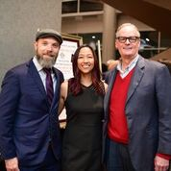
NJTL Gala
From left: Randy Ortwein, Vickie Jennings, Quinten Robertson,
Kien Huynh, Danielle Mora, Camille Blecher, Brad Blume
Four NJTL students received special recognition at the
Game Set Match Gala and Tennis Fashion Show in February.

Slide 11
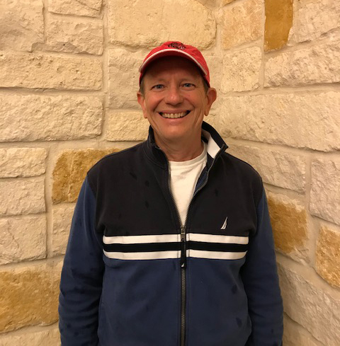
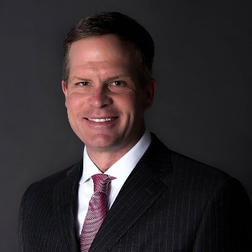
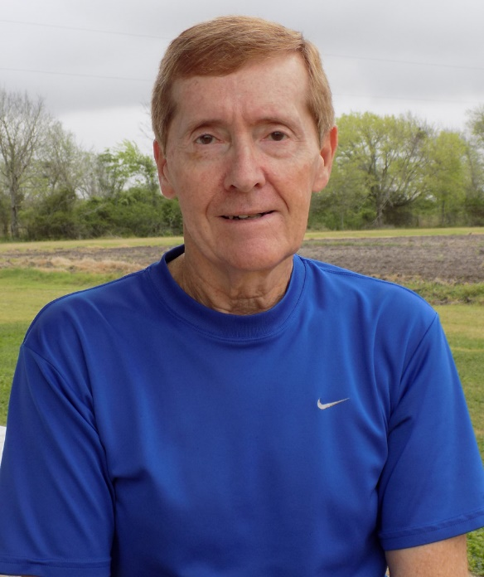
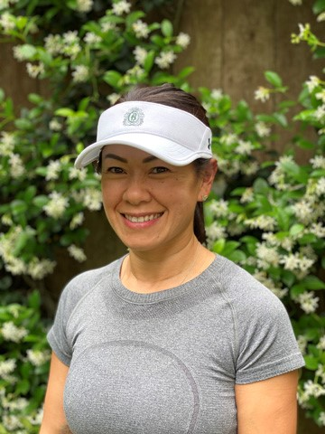
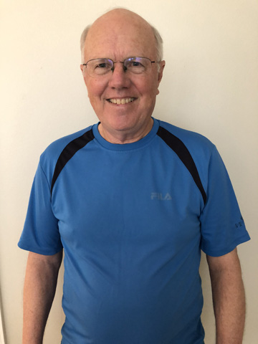
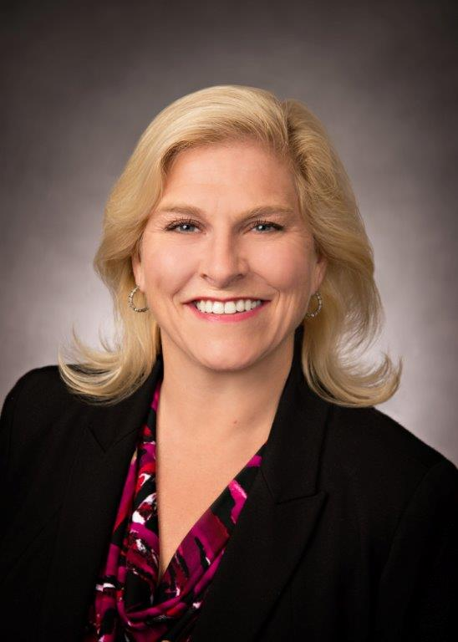
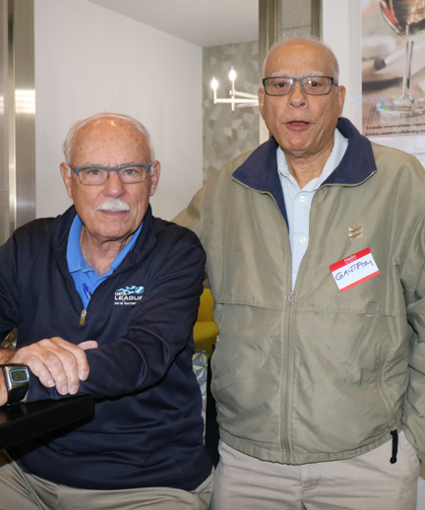
Team captains are the Greatest!

Slide 12
HTA has awarded more than $323,000 in scholarship funds to deserving high school seniors since 1992.
Students who received the 2020 grants and their high schools and college destinations are:
Turner Anderson, Montgomery, Texas A&M
Keshav Balaji, University of Missouri High, UT Arlington
Camille Blecher, home school, Texas A&M
Sebastian Delgado, Dobie, Lamar U
Noah Elzner, Ball High, Rice
Alexander Hong, Stratford, UT Austin
Katherine Johnston, St. John’s, Washington U in St. Louis
Chloe Ku, Clements, Case Western Reserve
Jadon Lau, Stratford, Northwestern
Armida Montemayor, Klein Forest, Lone Star-University Park
Paola Montoya, Galena Park, Texas State
Giselle Morales, Dobie, UofH Clear Lake
Kristy Morales, Dobie, UofH, Clear Lake
Emily Muckleroy, Ridge Point, Texas A&M
Gabriela Sandoval, Northbrook, UH
Tyler Tran, Glenda Dawson, UT Austin
Grayson Van Pelt, Clear Falls, Texas A&M
Jennifer Vu, George Bush, UH
The scholarships, which range from $1,000 to $2,000, will be awarded to high school students who have participated in high school varsity tennis and/or USTA Texas tournaments or programs and who are not attending college on a tennis scholarship.
In addition to HTA contributions, money for the scholarships has been provided by HTA National Junior Tennis & Learning, the National Senior Women’s Clay Court Championships (for a young woman), the Steve Wolford Memorial Scholarship Fund, Sean Rudolph Memorial Scholarship Fund, World Oilman’s Tennis Tournament, the HLTA Mary Gaines Memorial Fund, HLTA Scholarships, the LeMaster Husband & Wife Tournament Scholarships, West Houston Ladies Tennis Association and the Fayez Sarofim & Co. U.S. Men’s Clay Court Championships.

Slide 13


And then Covid…
Cancelled: The USTA National Senior Women’s Clay Court Championships March 30-April 5 at the Houston Racquet Club for ages 35, 45, 55, 65, 75, 85 and 90 had planned to celebrate its 50th anniversary with special events and a lot of hoopla for the more than 200 participants--many who fly in from all over the United States as well as from other countries.
In mid-March the USTA National Men’s 70 & 75 Indoor Championships at the Downtown Club at the Met was postponed.
The Fayez Sarofim & Co. U.S. Men's Clay Court Championship at River Oaks Country Club April 4-12 suffered the same fate when the ATP decided to cancel its tour.
Memorial Park, Lee LeClear and Homer Ford tennis centers closed at 11:59 p.m., March 24 until further notice at the City of Houston’s stay-at-home directive. As of this newsletter's publication date, neighborhood courts will remain open.
HTA took decisive action in mid-March and suspended all HTA spring leagues and USTA-sanctioned events until further notice through April 20 to ensure the health and safety of all.

Slide 14
Covid
Dated March 23, 2020 – USTA Statement on Suspension of Events
Due to the continued situation surrounding the COVID-19 virus and after discussions with the USTA Medical Advisory Committee, effective immediately, the USTA will extend the suspension of USTA sanctioned products and events, including Adult and Junior Tournaments, USTA League, Junior Team Tennis, Team Challenge, Team Tournaments, USTA Schools programs, Tennis on Campus and Wheelchair events through May 3. Additionally, recognizing the evolving and fast-changing nature of this situation, the USTA will continue to monitor and assess conditions to make future determinations about events and activities taking place after May 3.
GOOD NEWS! Did you know that tennis is among the Low Risk Activities
HTA will return to league play with modified leagues at this time. Tennis is rated No. 2 as the safest sport for participation. HTA's No.1 concern is the safety of our layers.

Slide 15


Slide 16
2021 HTA Spring Leagues
Team Registration Opens December 4, 2020
Team Registration Deadline January 4, 2021
HTA Spring Leagues
Ladies 18+ Doubles Tuesday Evening 4 doubles 19-January
Men's 18+ Doubles Thursday Evening 4 doubles 21-January
18+ Mixed Doubles Sunday Afternoon 4 doubles 24-January
18+ Ladies Singles Wednesday Evening 4 singles 20-January
18+ Men's Singles Monday Evening 4 singles 18-January
18+ Ladies Doubles Friday Day 4 doubles 22-January
Completion Deadline April 18
*******
Team Registration Opens January 4 Start Date
Team Registration Deadline February 5
USTA 40+ Mixed
7.0, 8.0 & 9.0 Wednesday Evening 3 mixed 17-February
Completion Deadline May 5

Slide 17

Wishing everyone the very best
And a Wonderful 2021

